Slide 1
CAREER INFORMATION & WORKFORCE READINESS TIPS for PSYCHOLOGY MAJORS
Presented by Psi Beta’s Executive Director Jerry Rudmann, PhD

Slide 2
An overview
The American Psychological Association’s research on psychology majors
How many students major in psychology?
Where do they go after earning the BA?
What kinds of jobs do they get?
What can psychology students do to make themselves more competitive in the job market?
Key skills available to psychology majors
Skills employers hope to see in college graduates
Psychology’s 21st Century Workplace Skills (some are unique)
Tips and resources to help students become job ready
College Career Centers
Self-Assessment Tools
Psi Beta’s Career Videos (Graduate School and CVs)
O*Net and Drew Appleby’s Extensive Resource
Experiential Learning Opportunities (e.g., CWE, Clubs, Internships)

Slide 3
Degrees in Psychology Source: Center for Workforce Studies (APA)

Slide 4
Career Information for Students with a BA in Psychology
This Photo by Unknown Author is licensed under CC BY-ND

Slide 5
Psychology BA Outcomes (2017)
Source: CWS @ APA

Slide 6
Examples of Psychology-Related Careers
Clinical Psychologist
MFT (Marriage & Family Therapist)
Social Work
School Psychologist
High School Counselor
College Counselor
Industrial Psychology / Human Factors
Psychology Teacher
High school
Community College
University
Research
Institutional (2 or 4-year colleges)
Academic (university psychology dept)
Private or public organization

Slide 7
Examples of Psychology-Related Careers and Degree Requirements
Clinical Psychologist PhD
MFT (Marriage & Family Therapist) (MA)
Social Work (MA)
School Psychologist (MA)
High School Counselor (MA)
College Counselor (MA)
Industrial Psychology / Human Factors (MA, PhD)
Psychology Teacher
High school (BA)
Community College (MA, PhD)
University (PhD)
Research
Institutional (2 or 4-year colleges) (BA, MA, PhD)
Academic (university psychology dept) (PhD)
Private or public organization (BA, MA, PhD)

Slide 8
Can you get a job with a BA in psychology?
An undergraduate psychology major prepares students for many career outcomes. In 2019, individuals with psychology bachelor’s degrees worked in 88 different occupational categories. Top work activities included management (31%) and professional services (19%), and sales (17%), often leading to management occupations (26%) and business and financial operations (12%).
Source: EMSI’s skills database – EMSI is a labor market analytics organization. Findings derived by analyzing profiles of individuals with psychology graduate degrees (i.e., resumés on job sites, digital profiles [LinkedIn], websites, other sources)
Analysis included individuals who earned psychology degrees in 1990 or later and now active in the workforce.

Slide 9
Five Broad Occupational Fields Psychology Majors (BA Degree) Enter
Business
Health Care
Human Resources
Social Service
Teaching
Create and/or Deliver Healthcare Services, Manage Health Services or Facilities
Recruitment & Benefits, Training, Work Environment, Management
Promote welfare of individuals, families, groups, and communities (e.g., advocate for positive social change, suppress abuse, and so on)
K to 12 teaching. For high school teachers, TOPS (Teachers of Psychology in the Secondary Schools) provide many excellent resources for teaching psychology courses in high schools
Management, Sales, Finance, Advertising, Marketing, Public Relations

Slide 10
Where do psychology graduate work? A global view from the US Census Bureau.
https://www.census.gov/dataviz/visualizations/stem/stem-html/

Slide 11
A Word About Graduate School
What is graduate school? – Post BA, therefore “graduate school”
A Masters Degree – takes 2 or 3 years
PhD – takes 5 or 6 years
Finding the “right” program and getting into that program – a challenge
Graduate Record Exam (GRE)
Letters of Recommendation
Experiences that help qualify you
Notes:
EXPLAIN THAT MOST MA AND PHD PROGRAMS REQUIRE THESE:
A CERTAIN SCORE ON THE GRE (VERBAL AND MATHEMATICS)
3 LETTERS OF RECOMMENDATION FROM PROFESSORS
EXPERIENCES – E.G., RESEARCH EXPERIENCES, AND EXPERIENCES THAT SHOW YOU AND SELF-MOTIVATED

Slide 12
2009 Survey of
Psychology Doctorates

Slide 13
Perceived Relationship of Job to Psychology
Degree in Psychology | My job is related to psychology | My job is closely related to psychology
BA | 62% | 27%
MA | 89% | 70%
PhD, PsyD | 97% | 85%

Slide 14
IVC’s Former Student: Graham Everette
****ADD IN FIREFIGHTER VIDEO

Slide 15
Job satisfaction of Psychology- Degree Holders

Slide 16
What is Career Readiness?
Career readiness is a foundation from which to demonstrate requisite core competencies that broadly prepare the college educated for success in the workplace and lifelong career management – National Association of Colleges and Employers, 2021

Slide 17
Salaries – EARLY CAREERS IN PSYCHOLOGY
Starting Annual Salaries
$65K- $93K

Slide 18
SALARIES – LATE CAREERS IN PSYCHOLOGY
Annual Salaries
$90K- $240K

Slide 19
Psychology Offers Universal Job Skills
The “Skills Gap” Skills employers want but graduates lack
What are the skills that employers desire in new employees? Can psychology help students acquire them?
Human Skills (“Soft Skills”) are essential for job success – regardless of your job area

Slide 20
21st Century Workplace Skills 17 skills within 5 major areas
Notes:
This document was published by the American Psychological Association in 2018.
An APA taskforce of psychologists analyzed a large number of job advertisements in which the Psychology BA was one of the qualifying degrees sought for job applicants.
The skills identified were organized into the following 5 skills domains: Cognitive Skills, Communication Skills, Personal Skills, Social Skills, and Technological Skills.
17 different specific skills were identified.
MAIN POINT: THE ARE THE SKILLS EXPECTED OF A PERSON WHO EARNS THE BA IN PSYCHOLOGY.
MAIN POINT 2: BUT, THESE ARE ASPIRATIONAL SKILLS. UNLESS YOU TAKE MAXIMUM ADVANTAGE OF YOUR CLASSES & CO-CURRICULAR LEARNING OPPORTUNITIES. YOU MAY NOT HAVE ALL THESE IMPORTANT SKILLS WHEN YOU GRADUATE WITH THAT BA.
MAIN POINT 3: YOU NEED TO TAKE CHARGE OF YOUR OWN SELF-DEVELOPMENT. HOW? NEXT SLIDE – THE PDEC.

Slide 21
What Employers Expect from Psychology BA Graduates…
This Photo by Unknown Author is licensed under CC BY-ND

Slide 22
Soft Skills – Source: Reality Works Inc.
Communication
Teamwork
Problem Solving
Critical Thinking
Using Technology
Time Management
Interviewing
Motivation
Work Ethic
Listening
11. Respect
12. Responsibility
13. Flexibility
14. Interpersonal Skills
15. Negotiation
16. Networking
17. Patience
18. Presentation Skills
19. Self-Confidence
20. Stress Management

Slide 23
21st Century Workplace Skill Building Tips
MONITOR PROGRESS - Keep close track of your “Essential Human Skills” knowledge and competencies
Self-assess your progress (PDEC, ESSI)
Create and periodically update your curriculum vitae (CV)
Skillify your job application letters, answers to interview questions
BUILD SKILLS - Take skill-building courses & workshops both within and outside your major
GAIN EXPERIENCES - Take advantage in “high impact” co-curricular learning opportunities
Career-related clubs, honor societies
Internships, Cooperative Work Experience (CWE)
Service Learning, Field Experiences Study Away
Undergraduate Research
NETWORK – Join (student memberships) professional organizations related to your career interests
USE CAREER RESOURCES
College career center
CWS or O*NET resources

Slide 24
Monitor Your Skill Building and Experience Acquisition Progress

Slide 25
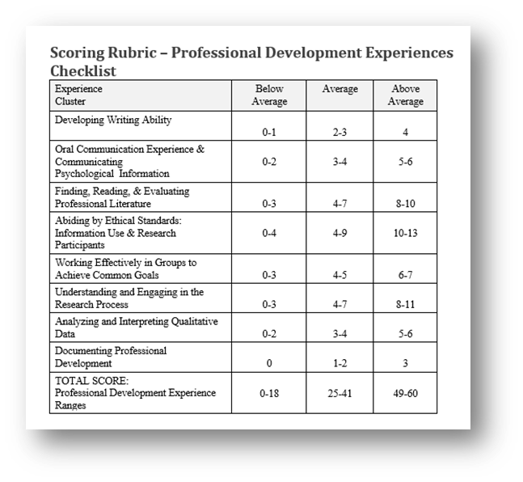
Assess your professional development progress using
the PDEQ

Slide 26
https://www.employableskills.com/about.asp

Slide 27
Top skills possessed by psychology majors included customer service (57%), leadership (49%), Microsoft Office (49%), management (48%), and sales (41%).
Data source: EMSI’s skills database – EMSI is a labor market analytics organization. Findings derived by analyzing profiles of individuals with psychology graduate degrees (i.e., resumes on job sites, digital profiles [LinkedIn], websites, other sources)
Analysis included individuals who earned psychology degrees in 1990 or later and now active in the workforce.
Chart source: Conroy, J, Lin, L, & Stamm, K. (2021) cws@apa.org

Slide 28
Look for Career-Related Experience Opportunities
Volunteer Work – Cooperative Work Experience (CWE)
Study Abroad
Temporary Jobs
Campus Clubs, Honor Societies
Work Study
Join a Professional Organization (e.g., APA, APS) and become an active student member
Honors Program
Others

Slide 29
NorthBound Treatment center
Christian Trusk’s Cooperative Work Experience (CWE) Project
Substance Abuse Treatment Facility

Slide 30
Northbound’s main facility
Here they provide inpatient detox treatment and hospitalization. As many as 87 clients stay at this facility for treatment for up to 90 days.

Slide 31
Typically, clients at this facility will get sober in the detox section in up to 10 days and then join the residential clients.
Clients spend most of the day participating in many types of group activities and therapies.
Following completion of the program, clients have many options for next steps. These include outpatient treatment, sober living environments, or transferring to another recovery treatment.

Slide 32
Cooperative work experience agreement: 1 unit of college credit for volunteering 60 hours 3 learning objectives
Christian’s 3 learning objectives:
Learn about the process of mental health assessment and diagnostics through on-the-job training and experiences.
Acquire the experience of working with individuals struggling with addiction and mental health.
Learn to speak and write clinically about mental health and addiction cases.

Slide 33
Working at Northbound
My time working at Northbound has been extremely enjoyable and more informative than any regular class ever I’ve taken!!
I spend most my time at Northbound interviewing and recording clients’ life stories.
I spend time in meetings with therapists consulting on clients’ treatment and how to make their recovery the best it can be.
In free time I shadow client groups and help facilitate groups.

Slide 34
What I’ve Learned by Volunteering for Cooperative Work Experience
That “there is a big difference between psychology classes and the actual experience of working with mental health clients! No book or class can replace experience!”
“Another thing that stands out is that these individuals aren’t just addicts, but they are people too! They have their own stories, desires, thoughts and feelings.”
“Most importantly through working here, I’ve learned about myself, and that psychology is the career area I want to pursue!”

Slide 35
Should you take cooperative work experience?
Absolutely!!! I can’t advocate for this class enough!!
Taking this class was the best thing I could have done for my education and Future!
It has taught me more than any other class! Also, it was exceedingly fun!

Slide 36
Take Advantage of Career Resources

Slide 37
Percentage of Employers Indicating They Would Be “Much More Likely to Consider” Hiring College Graduates With The Following Experiences Source: 2021 AAC&U Survey

Slide 38
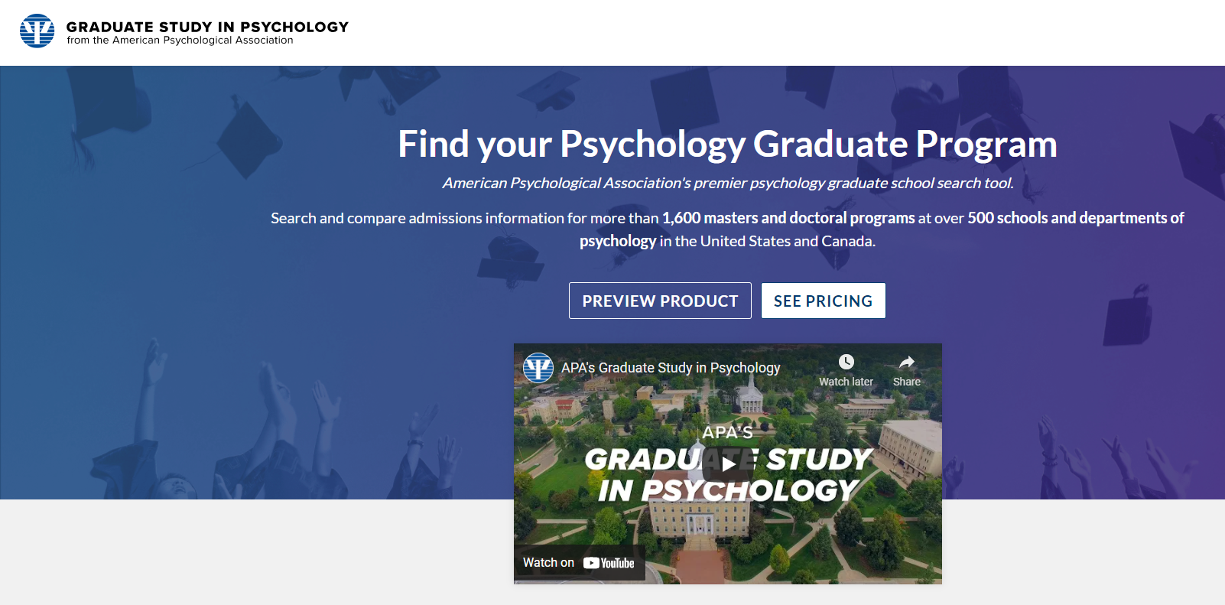
Graduate School Information Resources

Slide 39
Meet Kari Tucker (PhD, MA), Psi Beta Advisor at Irvine Valley College (CA) Since 2001
A personal story video about her experience of preparing and applying to graduate school.
If you plan to attend graduate school, this presentation is full of important tips and advice. Considering and Getting into Graduate School: Information and Tips I Wish I Had as an Early Undergraduate Student Video by Kari Tucker

Slide 40
Meet Bari Rudmann (MA, MFT) Academic counselor (retired) at Irvine Valley College (CA)
The Curriculum Vitae (CV) – a Video
A CV is a perfect way to continually monitor and update your professional development progress. If you “skillify” it, your CV will strengthen you chances of being hired. Curriculum Vitae – A Video by Bari Rudmann

Slide 41
Drew Appleby’s Career Exploration Resource
An Online Career-Exploration Resource for Psychology Majors – A comprehensive resource by Drew Appleby (This is amazing!)

Slide 42
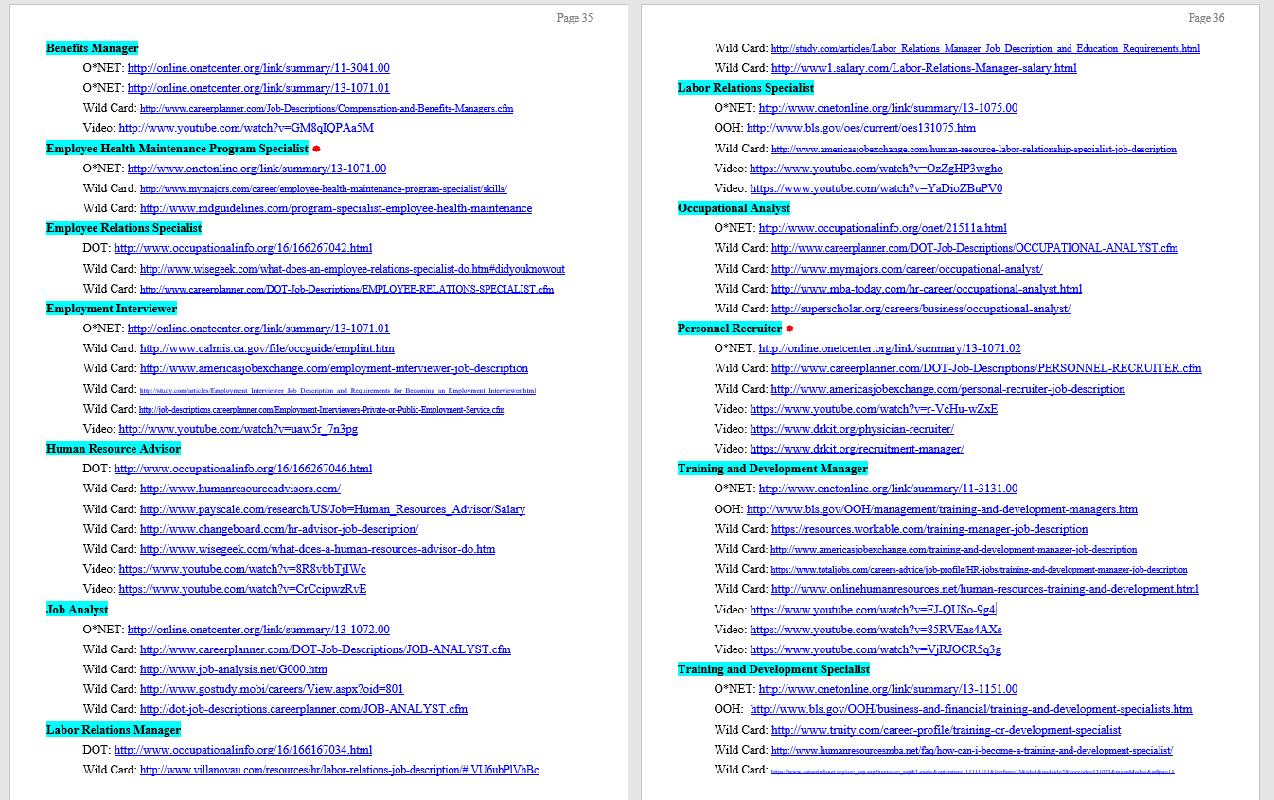
Human Resource Category Bring Up These Links

Slide 43
Clicking on the Human Resource Category Bring Up These Links

Slide 44
Training and Development Manager
O*NET: http://www.onetonline.org/link/summary/11-3131.00
OOH: http://www.bls.gov/OOH/management/training-and-development-managers.htm
Wild Card: https://resources.workable.com/training-manager-job-description
Wild Card: http://www.americasjobexchange.com/training-and-development-manager-job-description
Wild Card: https://www.totaljobs.com/careers-advice/job-profile/HR-jobs/training-and-development-manager-job-description
Wild Card: http://www.onlinehumanresources.net/human-resources-training-and-development.html
Video: https://www.youtube.com/watch?v=FJ-QUSo-9g4
Video: https://www.youtube.com/watch?v=85RVEas4AXs
Video: https://www.youtube.com/watch?v=VjRJOCR5q3g

Slide 45
Training and Development Manager
O*NET: http://www.onetonline.org/link/summary/11-3131.00
OOH: http://www.bls.gov/OOH/management/training-and-development-managers.htm
Wild Card: https://resources.workable.com/training-manager-job-description
Wild Card: http://www.americasjobexchange.com/training-and-development-manager-job-description
Wild Card: https://www.totaljobs.com/careers-advice/job-profile/HR-jobs/training-and-development-manager-job-description
Wild Card: http://www.onlinehumanresources.net/human-resources-training-and-development.html
Video: https://www.youtube.com/watch?v=FJ-QUSo-9g4
Video: https://www.youtube.com/watch?v=85RVEas4AXs
Video: https://www.youtube.com/watch?v=VjRJOCR5q3g

Slide 46
O*NET also provides, for this occupation: Interests Work Styles Work Values Related Occupations Wage and Employment Trends by State and Zip Code Sources of Additional Information

Slide 47
Career and Professional Development Resources https://psibeta.org/6909-2/
Videos
Curriculum Vitae video – Bari Rudmann
Preparing for and Getting Into Graduate School video – Kari Tucker
Self-Assessment Professional Development / Career Readiness Tools
Professional Development Experiences Checklist (PDEC) – Jerry Rudmann
The Employable Skills Self-Efficacy Survey (ESSES) – Natalie Ciarocco & David Strohmetz (online self-assessment – are you employable?)
Workplace Readiness Documents from APA’s 21st Century Workforce Skills Task Force
A Skills-Based Cover Letter – Produced by APA’s 21st Century Workforce Skills Task Force
A Skills-Based Resume / CV – Produced by APA’s 21st Century Workforce Skills Task Force
An Online Career-Exploration Resource for Psychology Majors – A comprehensive resource by Drew Appleby (This is amazing!)
Valuable Career Exploration Resources
US Census Bureau – Interactive Display “Where do College Graduates Work?” https://www.census.gov/dataviz/visualizations/stem/stem-html/
Careers in Psychology – A 29-page booklet from the American Psychological Association. It gives a good overview of a variety of career paths for students who earn a graduate degree (MA or PhD) in psychology. Free download at https://www.apa.org/careers/resources/guides/careers.pdf
O*NET – on online career exploration tool – https://www.onetonline.org

Slide 48
Closing Thoughts…
Self-regulation is one of psychology’s gifts
Time management
Sleep, diet, exercise
Growth mindset (Dweck)
Evidence-based study strategies
Take full control of your own self-development
If you don’t have a plan for yourself, then you will become part of someone else’s plan.
The Razor’s Edge

Slide 49
Thank You for Your Attention!!!

